Slide 1
HuBMAP + HPA – Hacking theHuman Body
Jenna Kim

Slide 2
Purpose
The purpose of this competition is distinguishing five different human organ(kidney, lung, intestine, spleen, prostate) by deep learning using image of cells.
To find this, the data should have special functional tissue units(FTUs) which make each organ different. However, it seems like almost impossible to annotate all FTUs since glomeruli FTUs which can be found on kidney are more than one million.
So, I think it is important to find the best algorithm using current annotated dataset.
To find the best algorithm, I think I need to solve two questions. First, I need to understand the dataset itself.
So, I overlap the RLE to image to see is there any specific thing I can see by each organ.

Slide 3
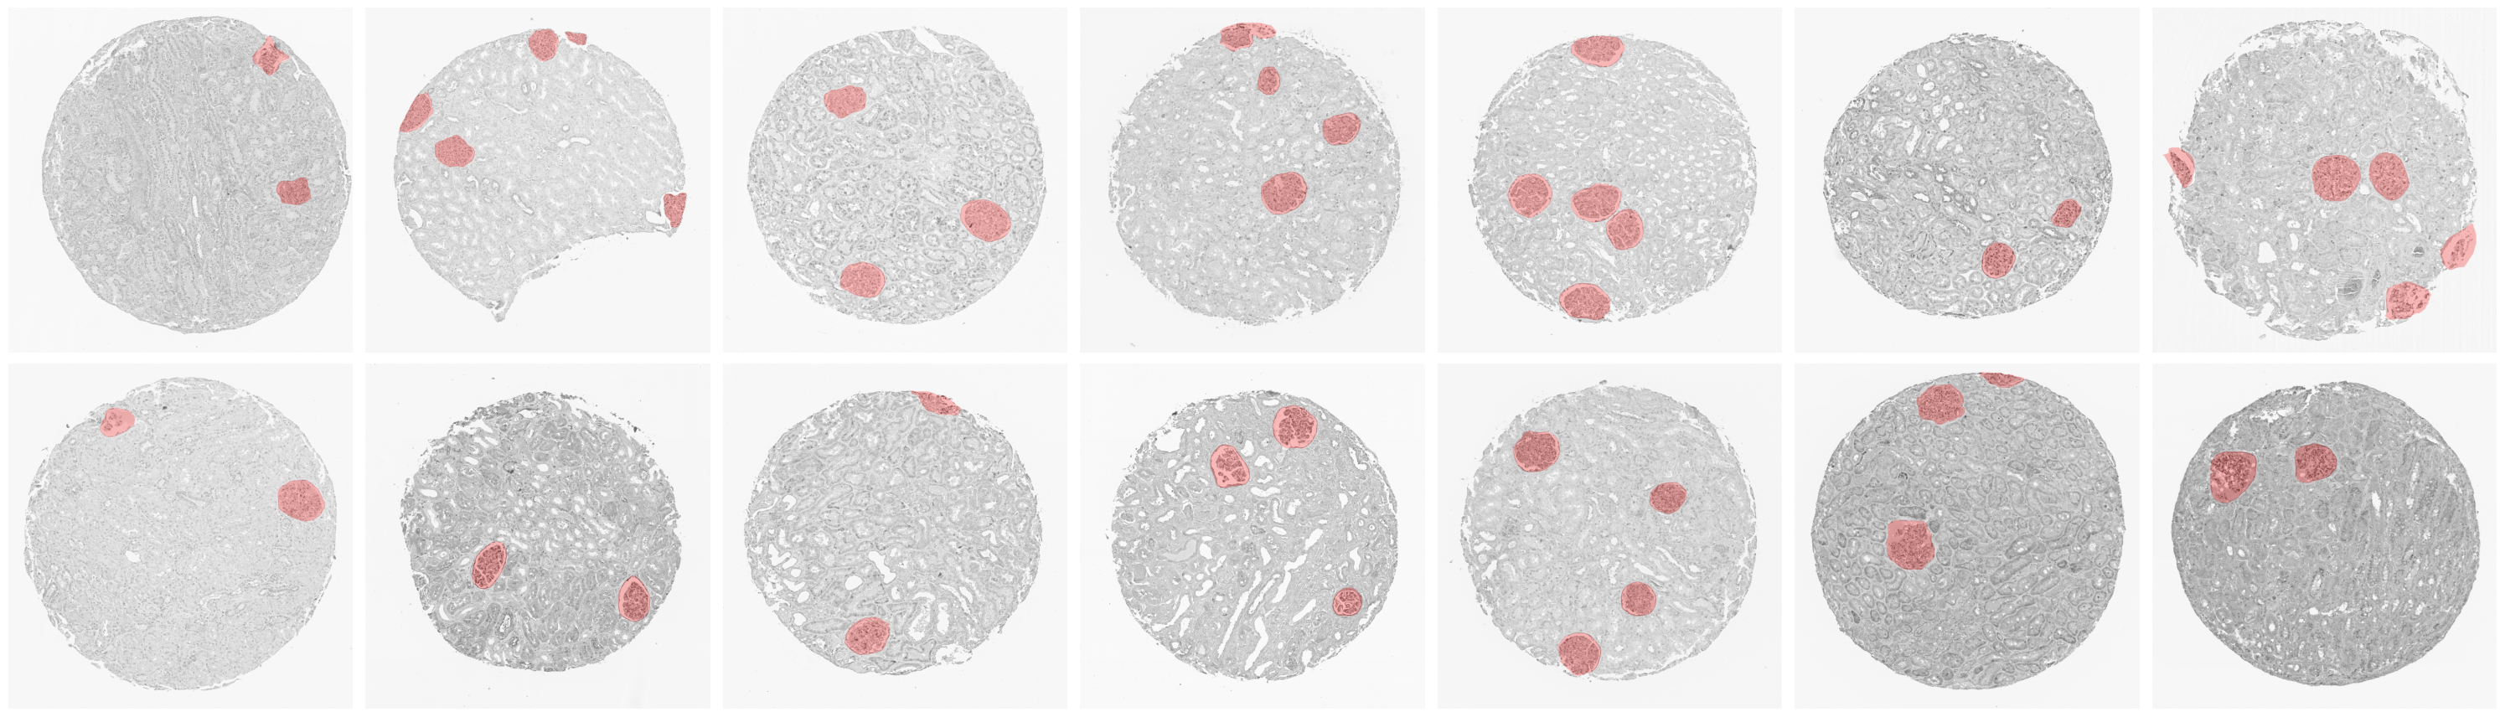
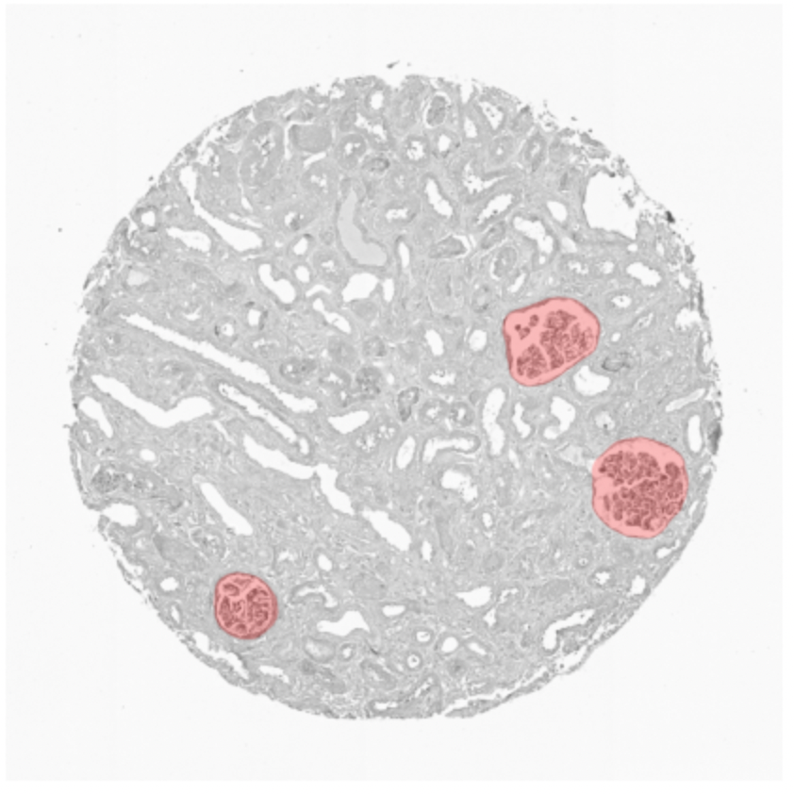
Kidney

Slide 4
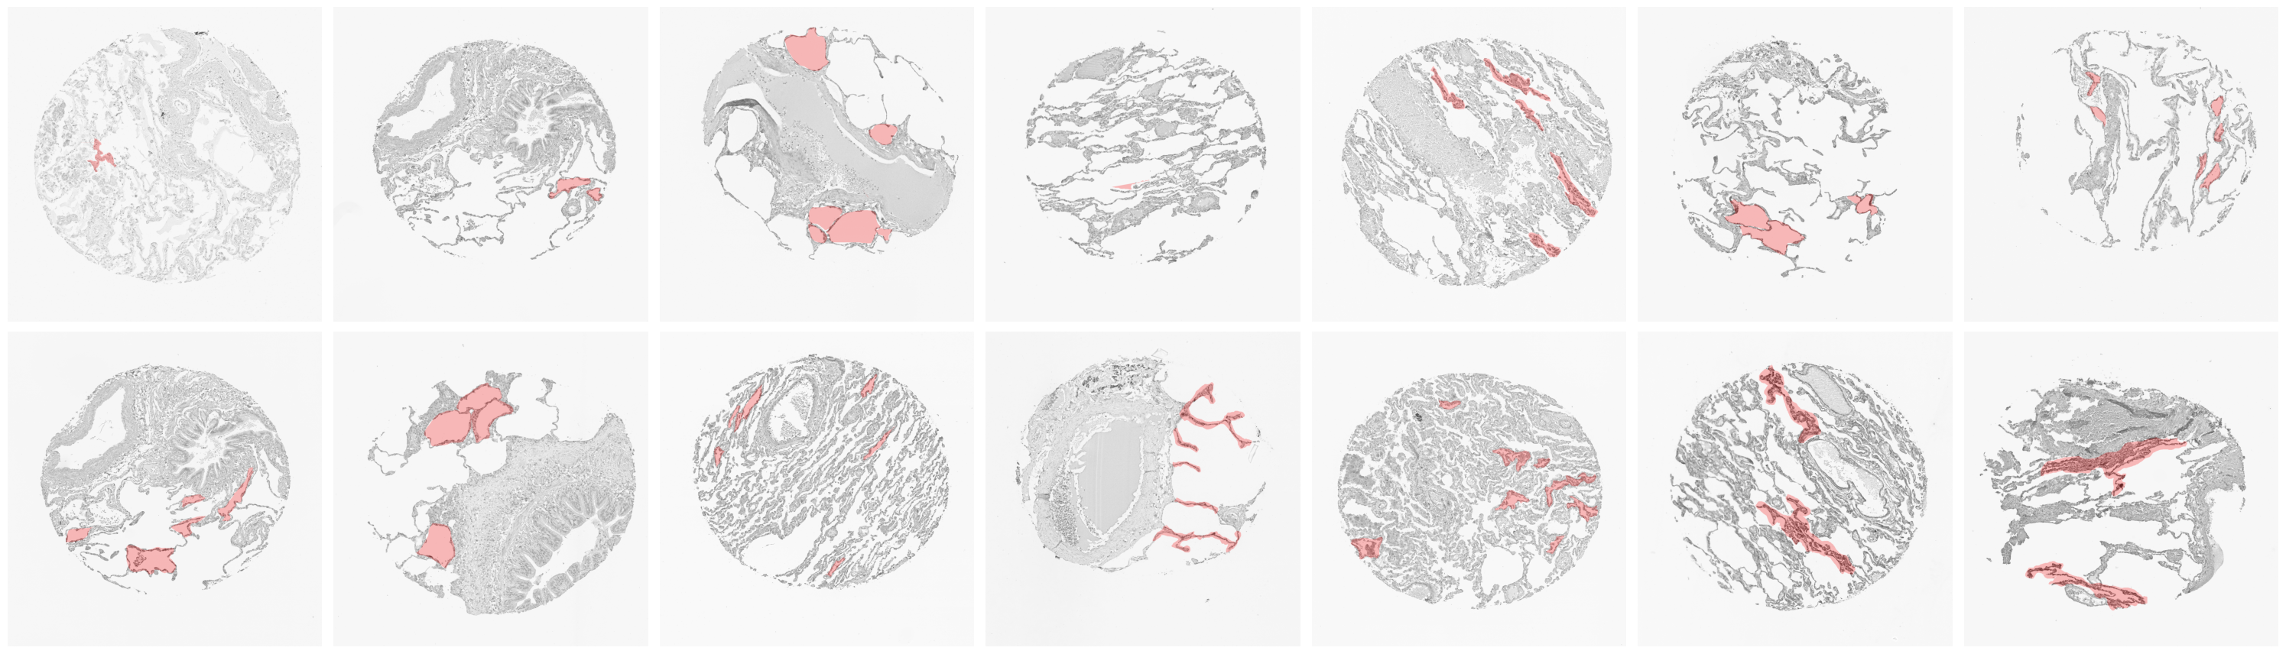
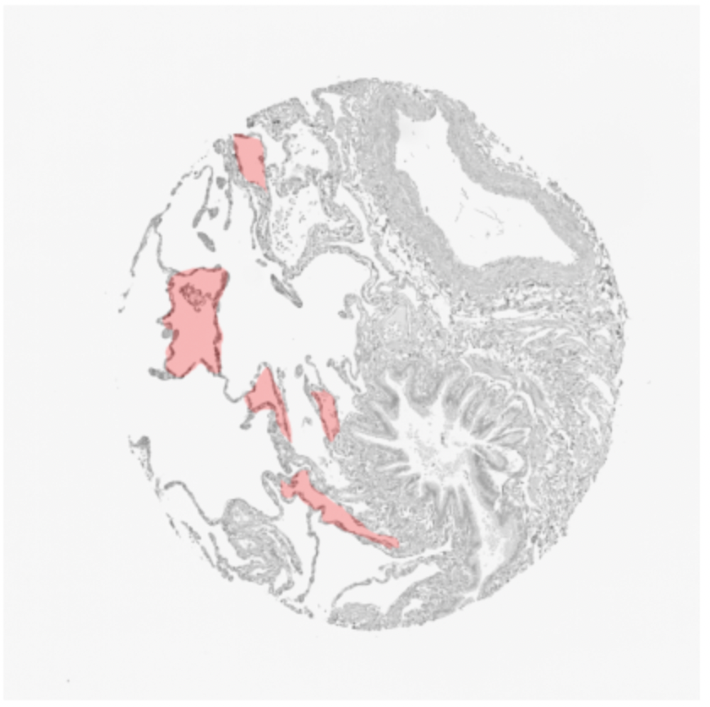
Lung

Slide 5
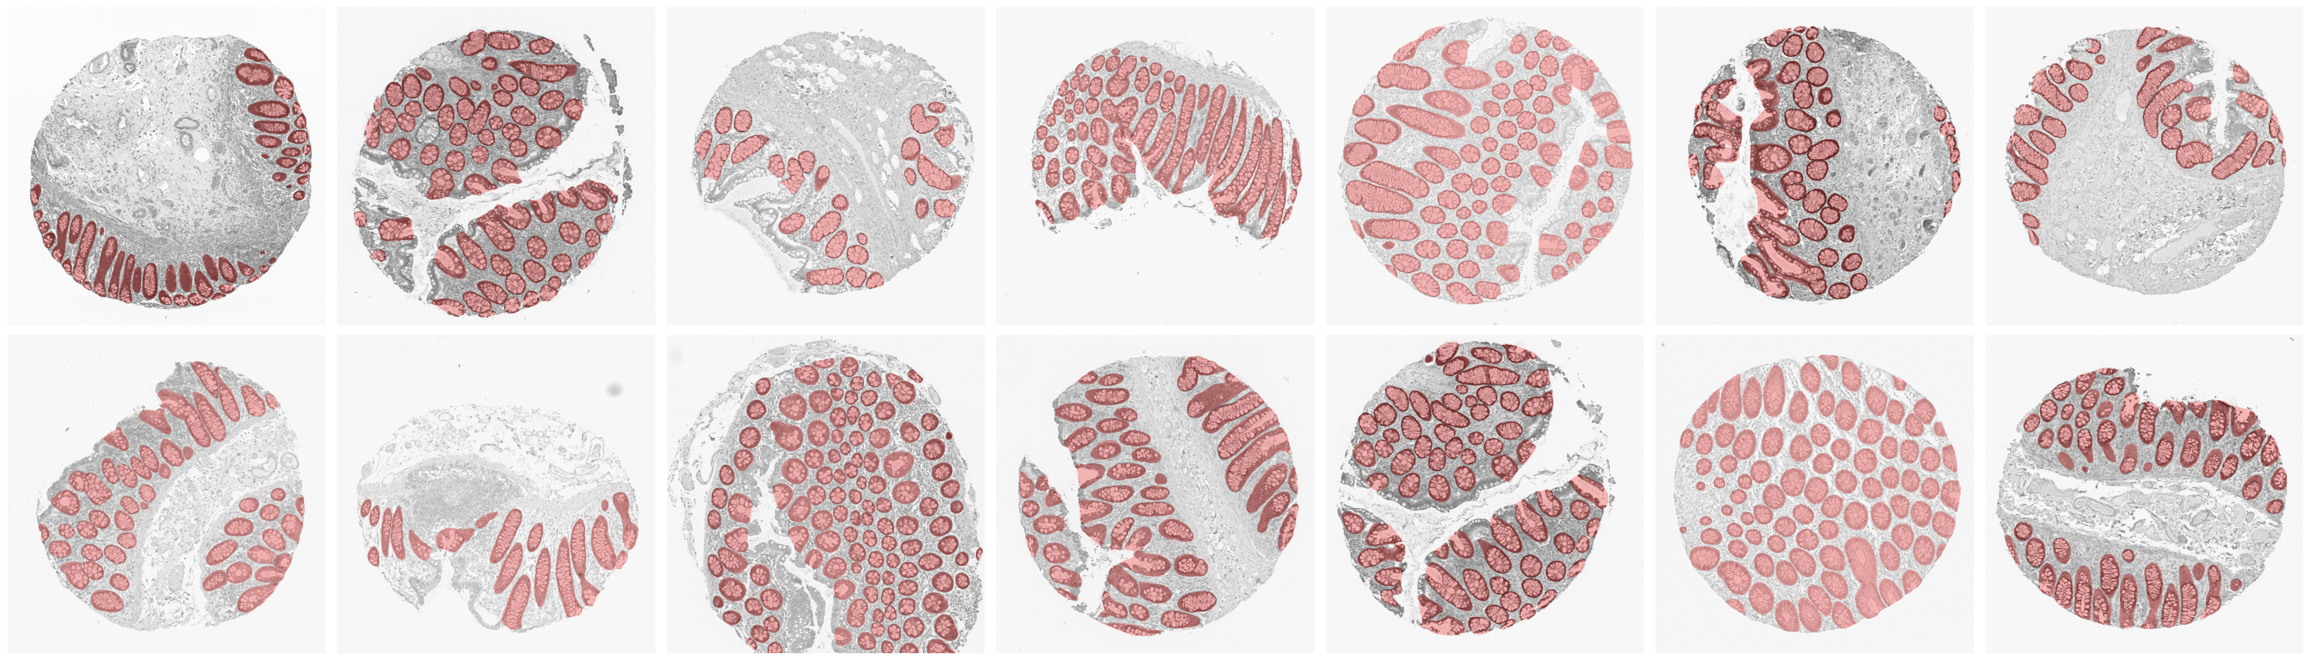
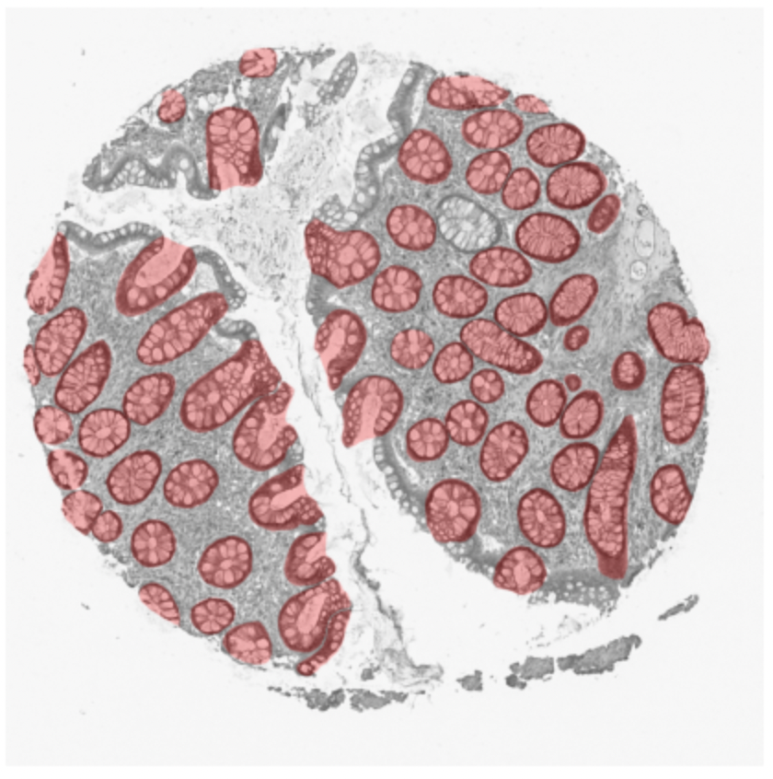
Intestine

Slide 6
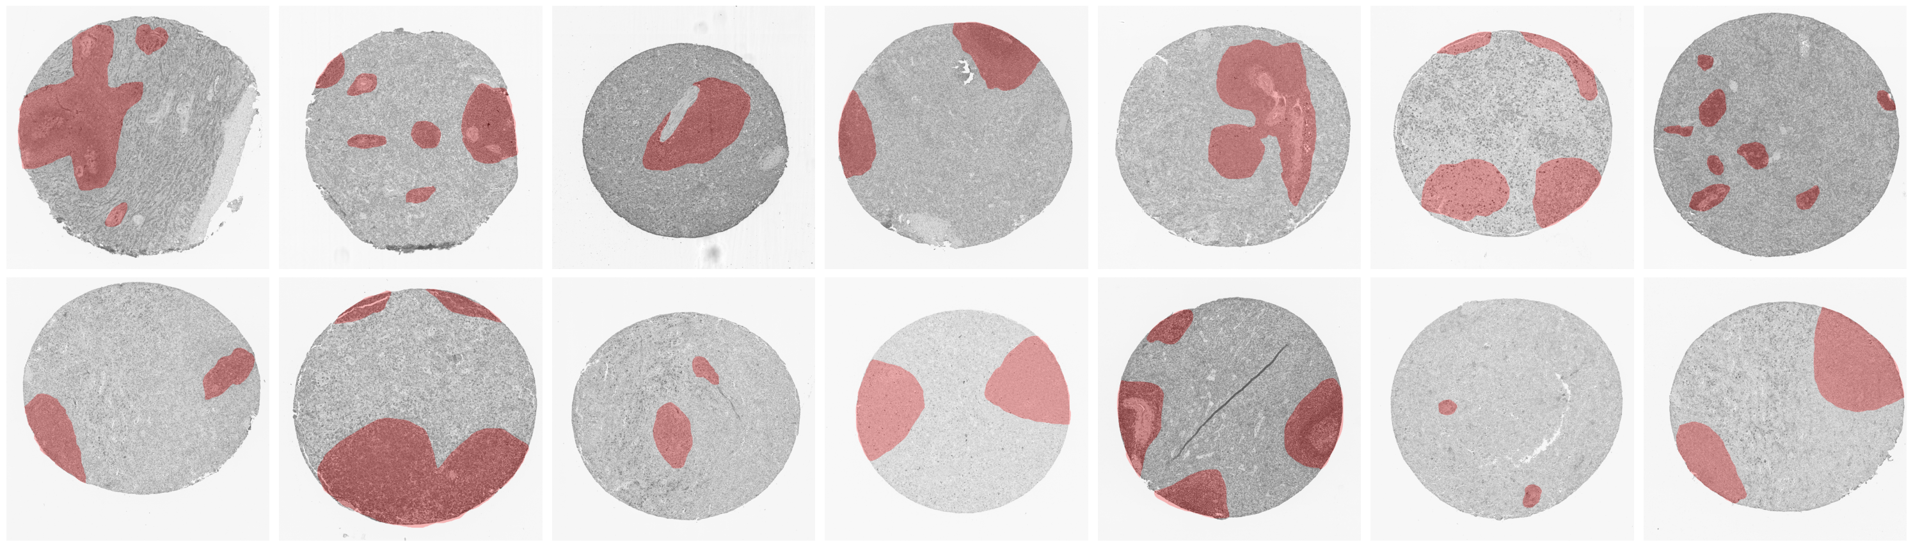
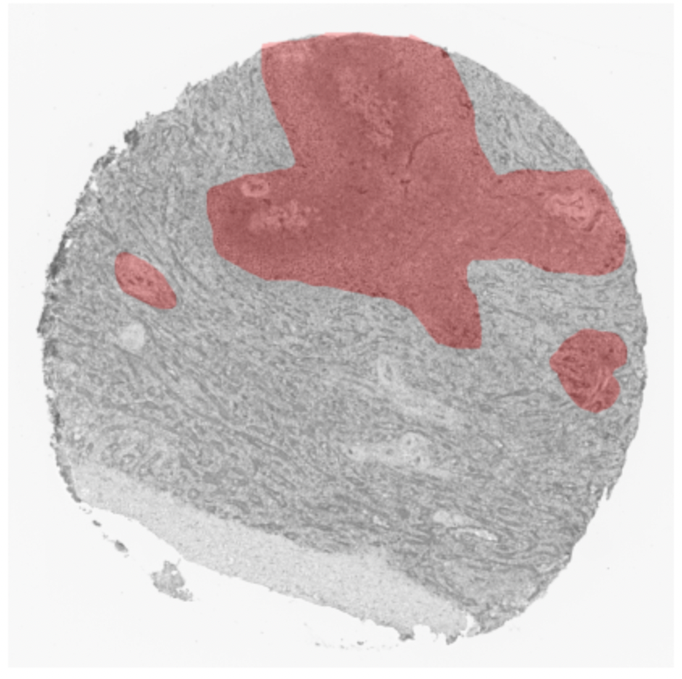
Spleen

Slide 7
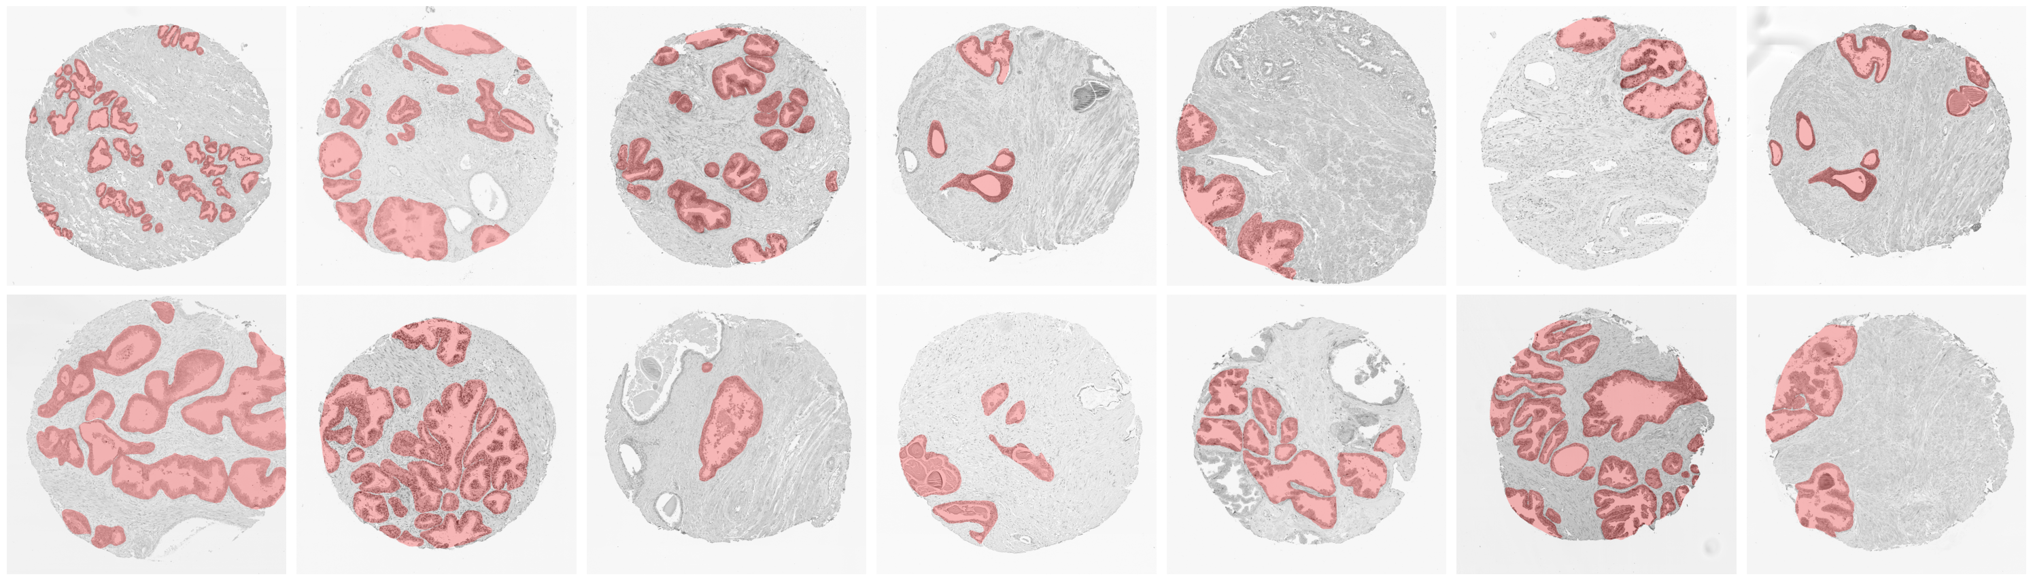
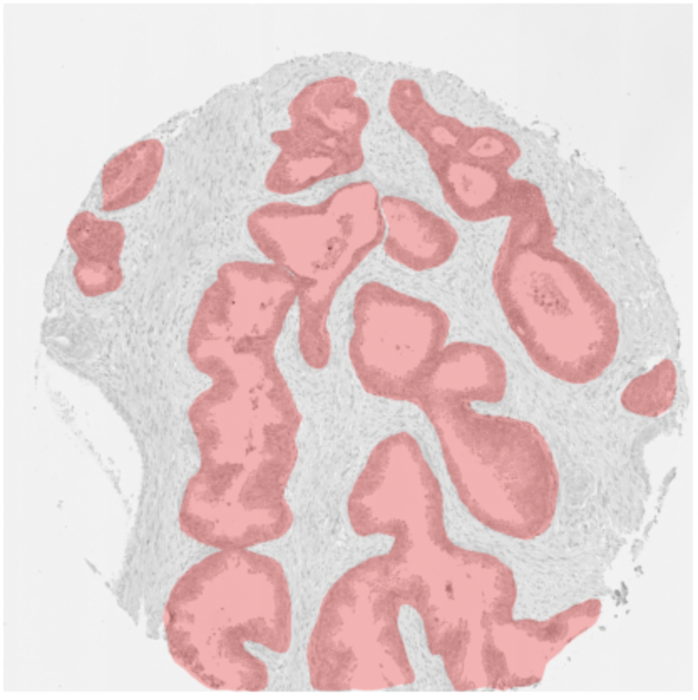
Prostate

Slide 8
Topic
…and I think I need to try K-fold or find best splitting way to see which training result shows the best results.
Second, adjust the network filter in efficient-unet and get best result. I think this will be very challenging and I need to study a lot but it is still challengeable.
On this point, since there are five organ and before competition is about kidney, so I want to choose one organ rest of four and run the training. If I see good result, then I can expand this to other organ one by one.

